Slide 1
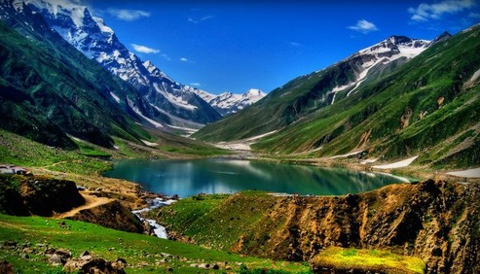


Humanitarian Development Continuum
The Hon. Tanveer Aslam Malik- Minister for HUD&PHED Punjab, Pakistan
High Level Ministerial Meeting , 15 and 16 March 2016
@sanwatforall
Notes:
Please insert:
A picture from your country (your minister, or a WASH programme, or a stakeholder meeting/…)
The flag from your country
The name/s or the Minister/s presenting

Slide 2
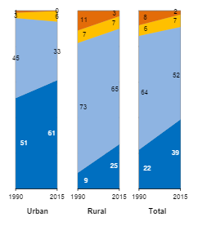
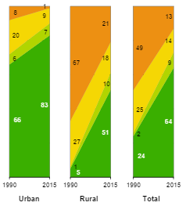
Pakistan’s Achievement of MDG Target on Sanitation in 2015
Water
Sanitation
Urban
Rural
National
Urban
Rural
National
Surface water
Open defecation
Unimproved
Unimproved
Improved
Shared
Piped on premises
Improved
% of population with access to improved water sources in 2015:
Urban:
Rural:
National:
JMP-2015 data
% of population with access to improved sanitation facilities in 2015:
Urban:
Rural:
National:
JMP-2015 data
94%
83%
90%
51%
91%
64%

