Slide 1
Turning around under-performing water and sanitation utilities and targeting the poor.
Neil Macleod

Slide 2
The Durban context
Historically institutionally disconnected, with a focus on technology and little focus on customers, finance or human resources management
In 2000 the city had 1 million people with first world water and sanitation services, 1 million people with poorly maintained and failing services and 1 million with no services – the population is now 3,7 million
40% of the population earn less than $1.25 a day
There is a mix of urban and rural development, with rapid densification taking place
Piped water services, safe from the tap have been extended to more than 1,4 milliom people.
Sanitation services have been extended to more than 800 000 people

Slide 9
The enabling environment is critical
A rights based approach to water and sanitation services provision enshrined in the Constitution with a subsidy policy that targets the provison of basic water and sanitation services to the poor
A supportive political structure at the municipal level led by a Mayor with a business-like approach to management in the public sector
A clear separation of the oversight and management roles together with strong regulation at a national level
‘Ring fenced’ financial accounts audited annually
Minimal pressure to engage in corruption or nepotism
‘Learning by doing’ in an organisational culture that encourages innovation, within clear risk boundaries

Slide 10
PROJECT POO
Percy Shangase

Slide 11
Expectations from a toilet
Based on a survey of hundreds of informal settlement residents
A place of refuge and contemplation
A place to be private and read, sing, cry, etc
A clean place that does not smell
Safe to use
Means the toilet must be private, clean, odour free, well lit and safe to access and use

Slide 12
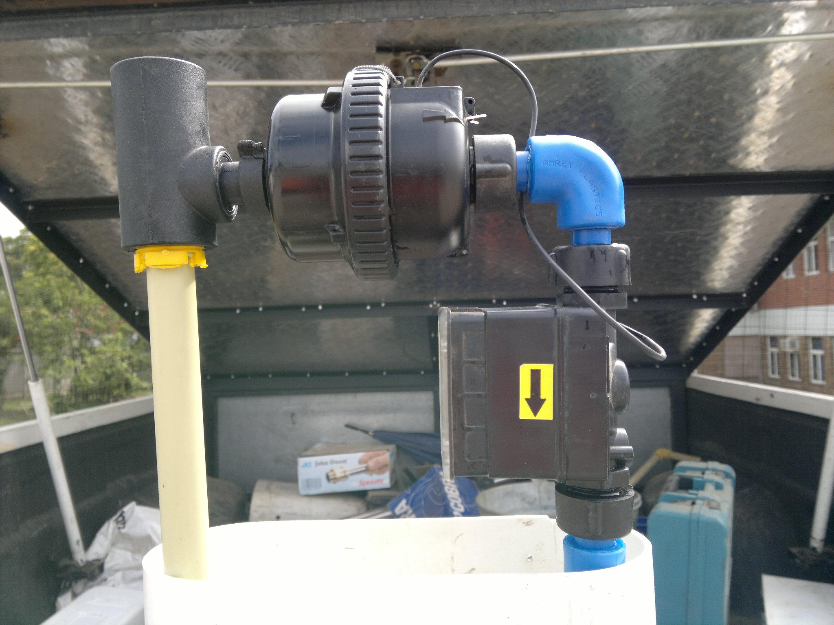
Flow limiter

Slide 13
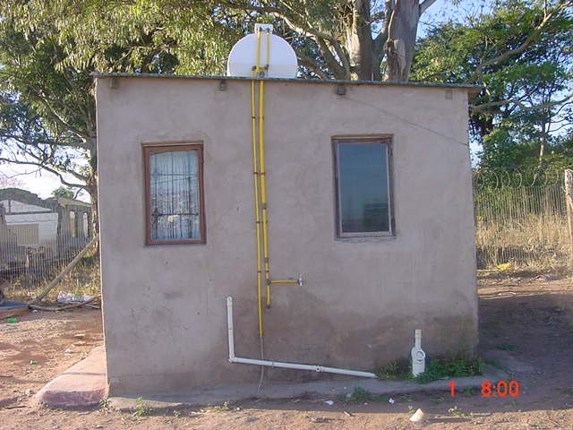

Slide 14
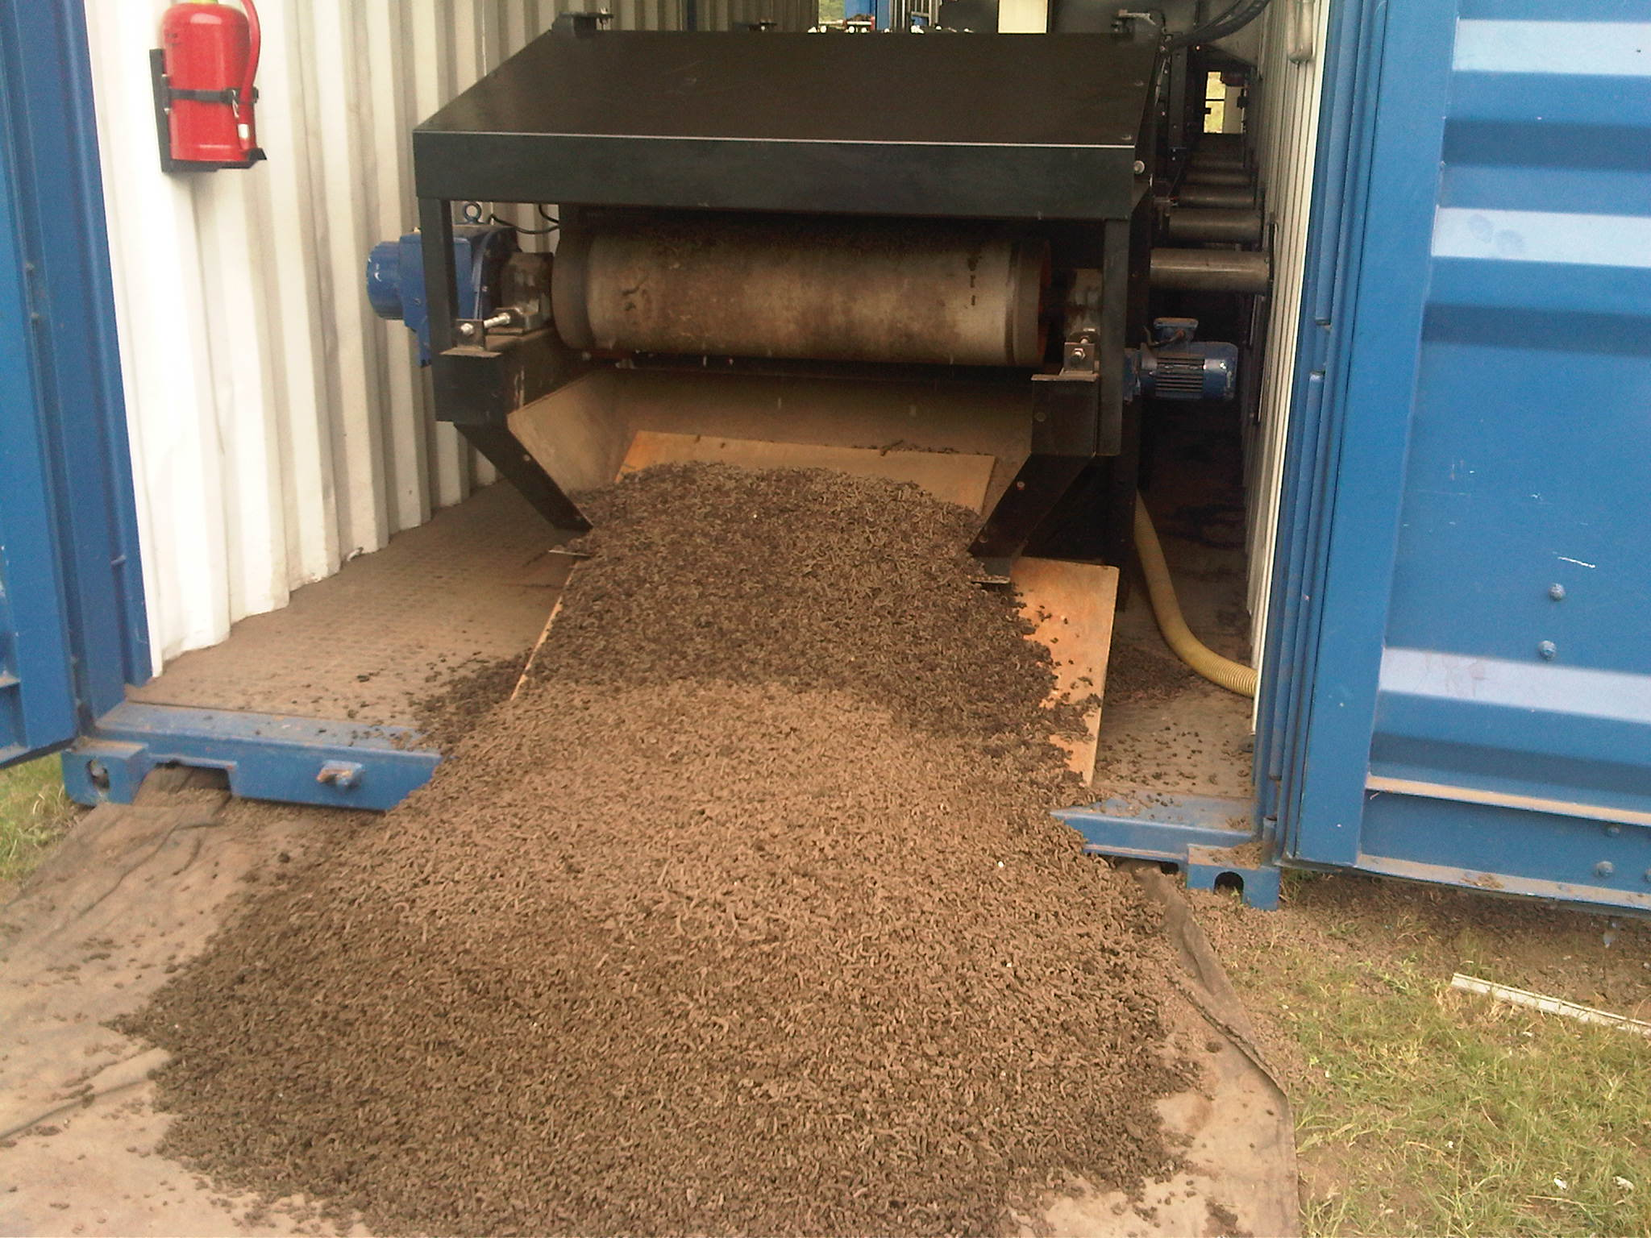

Slide 15
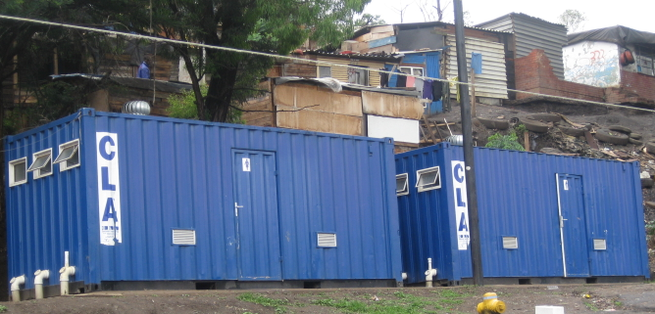

Slide 16
Stakeholder management
Secrecy is the enemy of good governance
Effective communication can overcome conflict and interference
Operate utilities using business principles with a social conscience
Present options from which to choose rather than a single proposal
Build trust incrementally

Slide 17
Regulation
For regulation to be effective, citizens must know what the regulations mean to them and how they can hold the service provider to account
This means extensive community engagement and the creation of meaningful platforms for communities to raise issues of concern to them

Slide 18
Asset Customer
Management Management
Network Revenue
Expansion Management
Human Resources Management

