Slide 1


Sanitation:
From MDGs to SDGs
BRIAN ARBOGAST
DIRECTOR OF WATER, SANITATION & HYGIENE
BILL & MELINDA GATES FOUNDATION
Notes:
Photo ID: PP380945
Eram Scientific Solution's Children E Toilets at the Manacaud School in Thiruvananthapuram, Kerala, India, on November 19, 2013.

Slide 2
The Way the World Was Measuring Progress in
Sanitation Was Insufficient
MDGs
Water closet
Sewer network pumping stations
Treatment plant
Sewerage
Vacuum truck
Fecal Sludge
Management
for on-site
systems
Latrine or
septic tank
Treatment plant
Primary emptying
Transfer
Notes:
The way the world was measuring progress in sanitation was insufficient. The current sanitation Millennium Development Goal (MDG 7.C, which targets a reduction in the number of people who don’t use a proper toilet) has been an important policy and advocacy tool to raise awareness about global sanitation needs. However, achieving this goal is necessary but not sufficient for addressing the broader issue of sustainable sanitation; a significant target to add is a reduction in the amount of fecal waste that gets discharged, untreated, into the environment. We worked with partners to propose language for the post-2015 (SDG) sanitation goal that would include safe waste management, and this has been finalized. We are now working to ensure that the appropriate indicators are also committed to.

Slide 3
The Way the World Was Measuring Progress in
Sanitation Was Insufficient
SDGs
Water closet
Sewer network pumping stations
Treatment plant
Sewerage
Vacuum truck
Fecal Sludge
Management
for on-site
systems
Latrine or
septic tank
Treatment plant
Primary emptying
Transfer

Slide 4
~2.7 billion people worldwide need fecal sludge management today
4
4
2
1
190
3
5
72
2
1,105
144
% of population served by:
0
593
1
3
5
5
Sewer
1
Septic
193
13
Flush/ pour flush pit
439
Pit - Dry
Other¹
Environment (Open Defecation)
87
3
xx
Current population of region with need for FSM (Million)
1. Open pits, pits without slabs and composting toilets included in "Other" as these do not need FSM (open pits/ pits without slabs covered up when full)
Source: UN JMP sanitation data, BCG analysis
Notes:
Today, ~2.7 billion people worldwide are served by sanitation methods that need fecal sludge management

Slide 5
Water scarcity Will make fecal sludge management even more important
Sub-Saharan Africa & Asia will be home to 74% of world's population
Future: 2030
‘000 litres/person/year
Extreme scarcity < 500
Scarcity 500-1,000
Stress 1,000-1,700
Adequate 1,700-4,000
Abundant 4,000-10,000
Surplus >10,000
No data
1. United Nations environment programme
Source: ‘Global Water Initiative’ (June 2005), GEF International Waters Conference, The Coca-Cola Company, Grail Research, BCG Analysis
Notes:
Water scarcity to be amplified in the future – India, China & Sub-Saharan Africa likely to be amongst most water stressed regions
Furthermore, growth of sewer networks will be particularly challenged in regions with water shortages

Slide 6
Poor FSM: institutional open defecation
Sludge direct to the environment: no service chain
2%
Effectively
treated
20%
WC to sewer
Leakage
79%
On-site facility
Not effectively
treated
2%
of fecal sludge safely disposed
Safely emptied
Illegally
dumped
Unsafely emptied
98%
of fecal sludge unsafely disposed
Left to overflow
or abandoned
1%
Open defecation
1%
69%
9%
9%
1%
9%
Source: WSP analysis, using BMGF funded research
Residential environment
Drainage systems
Receiving waters
Notes:
Analysis of Dhaka, Bangladesh
Note that even though only 1% of all waste is open defecation from the onset, with only 2% of all waste being treated the end result is still terrible.
From this one diagram you can see that:
Even though many people are using toilets connected to sewers, a remarkably low percentage (10%) of that waste stream is getting treated. Half of the untreated waste leaks along the way, and half simply gets dumped into various receiving waters (where people bathe, wash, etc.).
There is no support for safe, legal dumping of fecal sludge, so even the amount that is safely emptied winds up getting dumped, untreated.
Most of the waste simply overflows into the environment, within the area where people are living, children are playing, etc.
From the perspective of the MDG targets, this city is likely doing very well, as 99% of inhabitants seem to be using toilets.
However from a sanitation and health perspective, the situation is very poor.
This accentuates the need for us to be targeting and tracking more than just toilet use.

Slide 7
Partial FSM: framework in place, services exist
Some sludge safely transported and treated
18%
Effectively treated
21%
3%
25%
WC to sewer
Leakage
Not
effectively
treated
31%
of fecal sludge safely disposed
73%
On-site facility
Safely
emptied
Legally
dumped
69%
of fecal sludge unsafely disposed
Illegally
dumped
Unsafely
emptied
Safely abandoned
when full
10%
2%
Open defecation
2%
29%
10%
6%
17%
5%
Source: WSP analysis, using BMGF funded research
Residential environment
Drainage systems
Receiving waters
Notes:
Analysis of Dhaka, Bangladesh
Note that even though only 1% of all waste is open defecation from the onset, with only 2% of all waste being treated the end result is still terrible.
From this one diagram you can see that:
Even though many people are using toilets connected to sewers, a remarkably low percentage (10%) of that waste stream is getting treated. Half of the untreated waste leaks along the way, and half simply gets dumped into various receiving waters (where people bathe, wash, etc.).
There is no support for safe, legal dumping of fecal sludge, so even the amount that is safely emptied winds up getting dumped, untreated.
Most of the waste simply overflows into the environment, within the area where people are living, children are playing, etc.
From the perspective of the MDG targets, this city is likely doing very well, as 99% of inhabitants seem to be using toilets.
However from a sanitation and health perspective, the situation is very poor.
This accentuates the need for us to be targeting and tracking more than just toilet use.

Slide 8

THANK YOU
Notes:
Photo ID: coming via Stephen Walter
A young boy in Pune, India, 2014

Slide 9
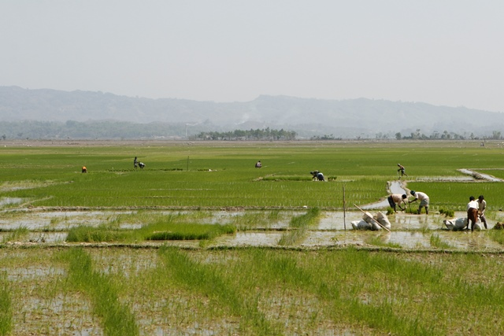
My Team’s Vision
The universal use of sustainable sanitation services
To contribute to this outcome, we make investments, forge partnerships, and advocate for opportunities that have the potential to make quality sanitation technologies and services safe and affordable for everyone.
Our ideal role is to catalyze high-impact investments that would not otherwise happen.
Notes:
Making sure children are healthy is at the center of our work as a foundation. There are a lot of ways to do this. We vaccinate them. We provide good nutrition and basic health care for mothers and their babies.
Sanitation is another critical intervention for ensuring that children not only live, but that they thrive.
Poor sanitation contributes to about 700,000 child deaths from diarrhea each year. Chronic diarrhea can hinder child development by impeding the absorption of essential nutrients and reducing the effectiveness of life-saving vaccines.
Further, poor sanitation undermines women’s and girl’s dignity and safety, and inflicts significant economic losses. In India alone, the economic losses associated with inadequate water supply and sanitation are estimated at $54 billion a year.
Creating sanitation infrastructure and public services that work for everyone and that keep waste out of the environment is a major challenge. The toilets, sewers, and wastewater treatment systems used in the developed world require vast amounts of land, energy, and water. And they are expensive to build, maintain and operate. Existing alternatives that are less expensive are often unappealing because they don’t kill disease-causing pathogens, have impractical designs, or retain odors and attract insects.

Slide 10
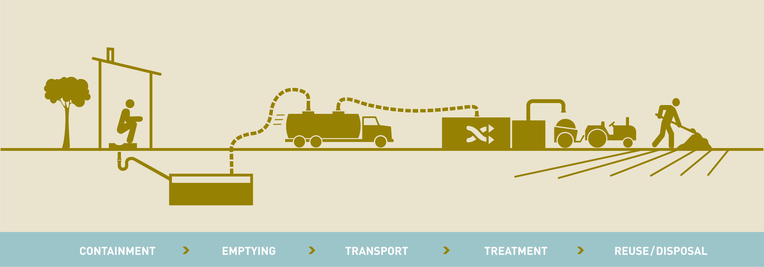
We Focus across the Sanitation Service Chain
We focus on two fundamental sanitation challenges:
  Expanding and improving sanitation without central sewers, because this is – and will be – by far the most common type of sanitation service used by the poor
  Making sanitation services safe and sustainable by addressing the failure to effectively transport, treat, and reuse waste captured in on-site facilities
Notes:
Our strategic focus is on the science, technologies, market approaches, processes, and tools that will transform the sanitation sector.
We are focusing on non-piped sanitation both because this is the type of sanitation used by the vast majority of the poor and because existing waterborne or sewered approaches are inappropriate for sustainable scale-up in many settings.
As the innovations we are supporting will be most readily adopted in densely populated areas, we are increasing our focus on urban sanitation. This means partnering with and investing in municipalities, private and public service providers, and community-based organizations that provide on-site sanitation services and fecal sludge management.

Slide 11
What Is Necessary for Transformation?
Political will
Proper institutional framework and regulatory environment
Successful FSM planning
Access to innovations: approaches, technologies, financing
Meaningful user participation
Notes:
Political will
Proper institutional framework and regulatory environment
Successful FSM planning
Requires sufficient human capacity
Development & sharing of expertise
Tools targeted to each phase (Diagnosis, Modeling, Implementation) and critical role
Requires financial arrangements, earmarked budgets and investment for O&M
Requires feedback loops that lead to refinement of plan
Access to innovations
New approaches, business models, public/private partnership structures, …
New technology options
New financing options
Meaningful user participation
Understanding user needs & priorities, through a gender lens
Innovative communication, campaigns to drive behavior change

Slide 12
How BMGF Is Engaging in Sanitation
Through Four Initiatives
Urban Sanitation Markets
Measurement, Evidence, and Dissemination for Scale
Policy, Advocacy, and Communications
Transformative Technologies

Slide 13
Urban Sanitation Markets
City Transformation
  Innovation
  Model cities
  Replication
Market and Industry Development

Slide 14
Case Study: Dakar
Multiple interventions combining to make it easier & cheaper for households to get their septic tanks emptied
  Call center drives bidding on jobs
  Bank loans support formalization of sector
  Public-private partnership drives improved results
These successes have built a partnership & platform for further innovation
  Now the site of our first Omni-Processor in field trial

Slide 15
Sanitation service chain: our investments
Water closet
Sewer network pumping stations
Treatment plant
Sewerage
Vacuum truck
Fecal Sludge
Management
for on-site
systems
Latrine or
septic tank
Treatment plant
Primary emptying
Transfer
Notes:
This slide positions the Transformative Technology (TT) investments we are making in the context of the sanitation service chain.

Slide 16
Sanitation service chain: our investments
Water closet
Sewer network pumping stations
Treatment plant
Sewerage
Vacuum truck
Fecal Sludge
Management
for on-site
systems
Latrine or
septic tank
Treatment plant
Primary emptying
Transfer
Omni-Ingestor
Notes:
Our Omni-Ingestor (OI) investments are focused on making it easier and cheaper for latrine pits – both wet and dry – and septic tanks to be safely emptied. (Today, the only option people have for emptying a dry pit is to hire a manual scavenger, who will then dump the contents as close to the residence as he can get away with.)

Slide 17
Sanitation service chain: our investments
Water closet
Sewer network pumping stations
Treatment plant
Sewerage
Vacuum truck
Fecal Sludge
Management
for on-site
systems
Latrine or
septic tank
Treatment plant
Primary emptying
Transfer
Omni-Processor
Notes:
Our Omni-Processor (OP) investments are focused on making it easier and cheaper for fecal sludge to be effectively treated, generating valuable outputs and allowing for the provision of smaller treatment centers that could be located closer to the population centers, reducing transport costs. Our aspiration is to develop technologies that would allow an entrepreneur to build a profitable business by attracting and treating fecal sludge.

Slide 18
Sanitation service chain: our investments
Water closet
Sewer network pumping stations
Treatment plant
Sewerage
Vacuum truck
Vacuum truck
Fecal Sludge
Management
for on-site
systems
Latrine or
septic tank
Latrine or
septic tank
Treatment plant
Treatment plant
Treatment plant
Primary emptying
Primary emptying
Primary emptying
Transfer
Transfer
Transfer
Reinvented Toilet
Notes:
Our Reinvented Toilet (RT) investments are focused on revolutionizing the sanitation service chain by collapsing it, i.e., by making the emptying of an RT an inherently safe exercise (as all pathogens have been removed) and obviating the need for any further transport or treatment of unsafe waste. In an RT, the onsite waste processing means that Containment = Treatment.

Slide 19
Sanitation service chain: our investments
Water closet
Sewer network pumping stations
Treatment plant
Sewerage
Vacuum truck
Fecal Sludge
Management
for on-site
systems
Latrine or
septic tank
Treatment plant
Treatment plant
Primary emptying
Transfer
Reinvented Toilet
Notes:
Our Reinvented Toilet (RT) investments are focused on revolutionizing the sanitation service chain by collapsing it, i.e., by making the emptying of an RT an inherently safe exercise (as all pathogens have been removed) and obviating the need for any further transport or treatment of unsafe waste. In an RT, the onsite waste processing means that Containment = Treatment.
Overall Specifications:
Affordable: less than $0.05/person/day (capital + O&M) now, moving towards $0.01/person/day (end goal).
Safe: remove all pathogens from the environment.
Recovers resources from human waste (energy, fertilizer, water, …)
Not connected to existing utilities (water, Electricity, Sewer)
Appealing: sustained use > 5 years.
User-centered: users create demand.
Sustainable: service providers (public or private) can recoup complete lifecycle costs (make a business work).

Slide 20

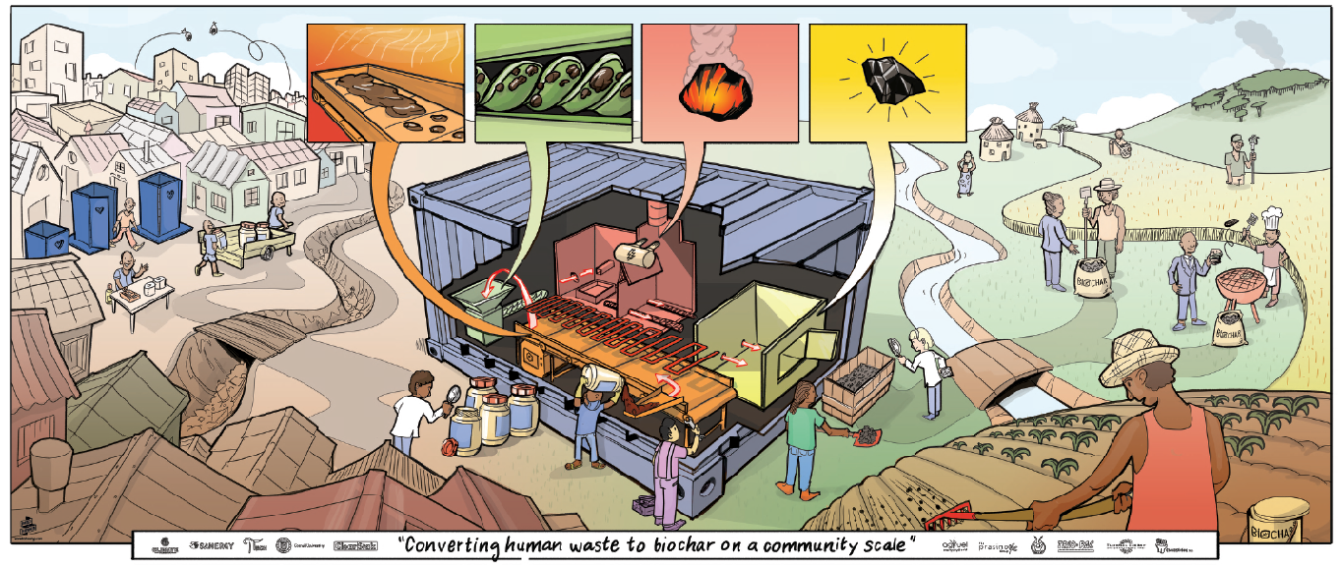

Biochar Omni-Processor
Produces:
fertilizer substrate
water
energy
nutrients
Accepts:
human
solid waste
organic matter and other biomass
Biochar Omni-Processor accepts human waste,
produces fertilizer substrate, water and energy,
without using grid or water or a sewer system.

Slide 21
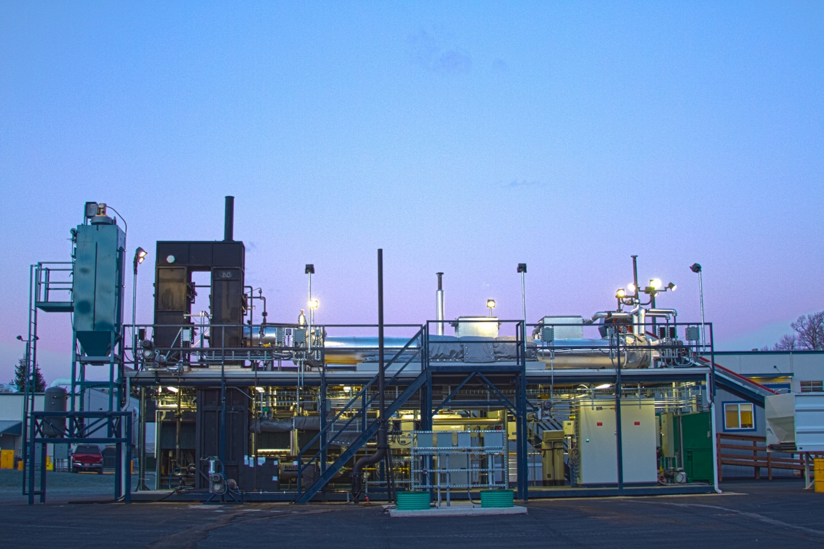
Janicki Omni-Processor
Turning Fecal Sludge
into Electricity
Population served ~ 100’000 people
Kills all pathogens
No harmful emissions
Electricity produced: 300 kW (250 kW net)
Potable water produced: 80,000 liter/day
Also produced: steam, dry sterile ash

