Slide 1


Building blocks for an effective WASH Sector
Eddy Perez
Professor of Practice in Global WASH, Emory
Consultant, UNICEF

Slide 2


"I believe that this nation should commit itself to landing a man on the moon by the end of the decade.”
President John F. Kennedy, May 25, 1961

Slide 3

Seven years after President Kennedy’s Vision

Slide 4
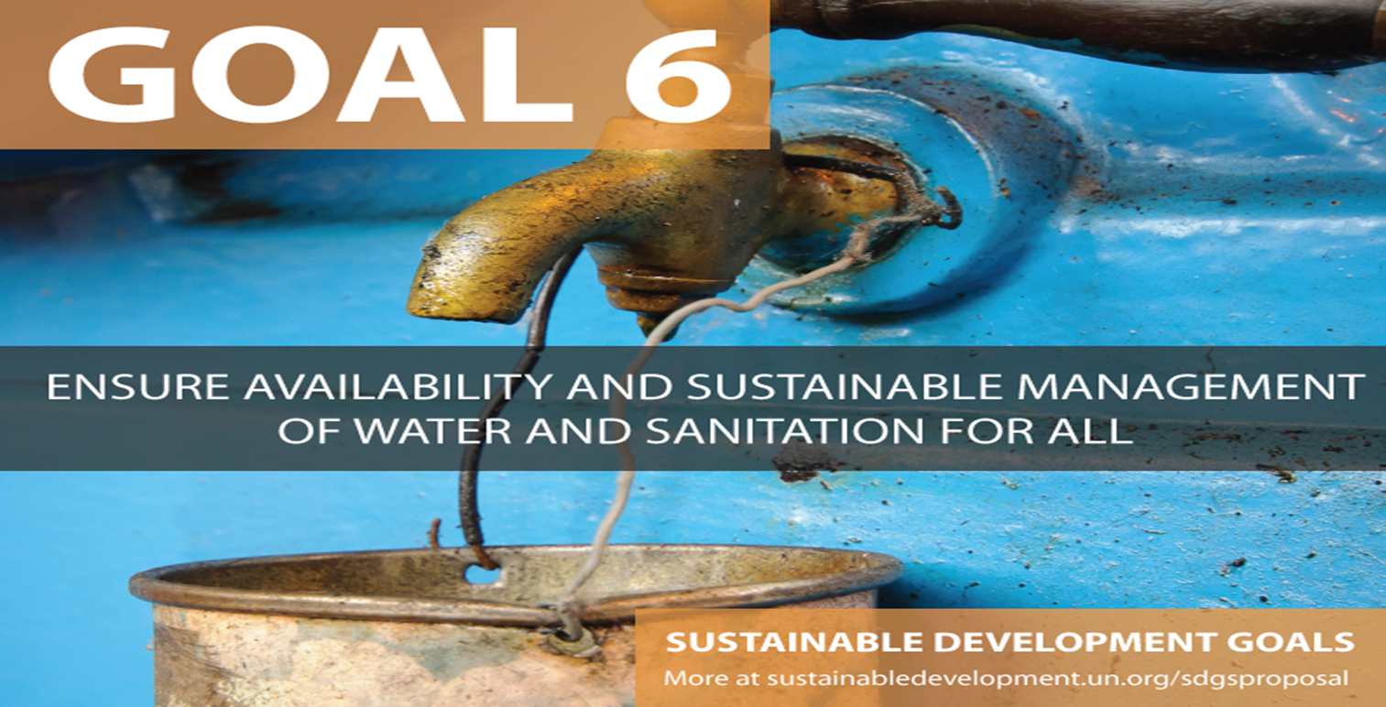
Political Leadership
Leaders in this room are convinced and motivated to achieve Goal SDG 6 that everyone should have access to sustainable WASH services b 2030
The political will to “stop doing business as usual” and reforming WASH service delivery is the starting point for strengthening the WASH Sector Building Blocks
Notes:
Political leaders at various levels (national, state and local government) identify WASH as a political priority and serve as champions. The higher the level of leadership, the stronger the impact of political will.

Slide 5
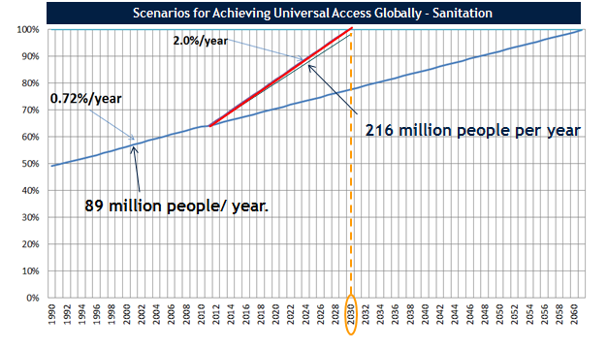

Business as Usual
Will NOT achieve Universal Sanitation Access by 2030
89 million people/ year.
Source: author using unpublished prepared by WSP/WB using JMP data

Slide 6
Building blocks for an effective WASH Sector
Sector Policy / Strategy
Institutional arrangements
Sector Financing
Planning, Monitoring and Review
Capacity Development
PLUS
Regulation & Accountability

Slide 7

Sector Policy / Strategy
Evidence informed policies at national and subnational levels for all WASH subsectors and for both households and institutions - backed by a legal framework, is approved by cabinet and used by stakeholders
Notes:
Policy is the set of procedures, rules, and allocation mechanisms that provide the basis for programs and services.
Policies set the priorities and often allocate resources for implementation.
Policies are reflected in laws and regulations
Policy enforced with clear accountabilities
Policies/strategies must consider:
All sub-sectors (urban, rural, drinking water and sanitation)
National and subnational levels

Slide 8

Institutional arrangements
The right institutions (Public, Private and Non-Governmental) must be in place with all key roles and functions covered and clearly understood.
Also includes “at scale” and sustainable WASH subsector service delivery arrangements/models
Notes:
Institutional arrangements include the mechanisms for actors at all levels to coordinate their activities and establish partnerships between the public, private, and non-governmental organization (NGO) sectors, and between communities and local governments.
Legal and regulatory frameworks to underpin the desired targets and reinforce roles and allocation of resources
National lead institution identified for each subsector
Coordination mechanisms are established
Dedicated budget lines
Clear operational structure and capacity
A variety of WASH service delivery arrangements involve civil society organizations, small service providers, transnational companies, different ministries and delegated branches of the government, local government and municipal companies, etc.
The models include provisions for targeting most vulnerable people with standards for affordable services in place
The sector delivery models consider different options, including private sector participation

Slide 9
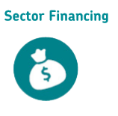
Sector Financing
Adequate arrangements for financing WASH service delivery, including capital and programmatic costs. Realistic and transparent sector budget with identifiable funding streams
Notes:
Sector is able to attract different sources of funding
Existence of legal and institutional frameworks for financial transactions to take place
Public allocations to water and sanitation as % GDP
Existence of financing institutions
Expenditure Framework which matches government priorities with available resources
Realistic and transparent sector budget with identifiable funding streams
Availability and use of data on financing streams including the 3Ts (taxes, tariffs and transfers) and comparable, realistic estimates for all sector cost categories for sustainable service delivery.

Slide 10
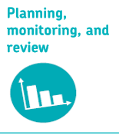
Planning, Monitoring, Learning and Review
Government led national WASH plan and roadmap for SDG Goals for WASH have been validated and “owned” by range of stakeholders and are operational.
Effective, inclusive and systematic research, monitoring, learning, and evaluation of sector performance to improve service delivery and achievement of goals
Notes:
Planning is the process of thinking about and organizing the activities required to achieve a desired goal.
National plan owned by Government and endorsed by other stakeholders
Developing a shared vision and strategy for a WASH sector plan in a collaborative manner is the foundation for coordination and for creating motivation at all levels.
Time bound roadmap with resources (human and financial) in place
Strategic and risk-informed plan with clear targets, timeline and milestones
Traditional and community leaders represented and engaged in planning process

Slide 11
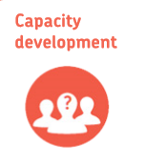
Capacity Development
Stakeholders and institutions possess the human , technical, and financial resources to execute their accountabilities with an institutionalized structure in place with sustainable financing to ensure continuous renewal and/or adaptation of capacities
Notes:
Government led capacity development with overarching plan based on needs assessment
Public and private institutions at all levels must have the capacity to carry out their roles and responsibilities for effective WASH service delivery at scale.
Institutional capacity includes adequate human resources with the full range of skills required to carry out their functions, an “organizational home” within the institution that has the assigned responsibility, mastery of the agreed-upon program methodology, systems and procedures required for implementation
Ability to monitor program effectiveness and make continual adjustments.
Different institutional stakeholders/providers have own capacity development plan

Slide 12
Regulation & Accountability
Mechanisms for interaction and information exchange between government, service providers and citizens exist and independent institutions exert oversight and control, and drive improvements in WASH services
Notes:
Regulations are rules or governmental orders designed to control or govern behavior and often have the force of law. Regulations can cover a wide range of topics, including the practices of service providers, design standards, tariffs, discharge standards, environmental protection, and contracts.
Accountability in the WASH sector is the democratic principle whereby elected officials and those in charge of providing access to water supply and sanitation services account for their actions and answer to those they serve

Slide 13
Process for Strengthening WASH Building Blocks
Agree to Change
Assess what is needed to strengthen WASH building blocks
Develop a government led and evidence informed plan to strengthen the building blocks
Identify Bottlenecks in WASH Building Blocks
Implement multi-stakeholder program to strengthen building Blocks
Monitor, learn and improve

Slide 14
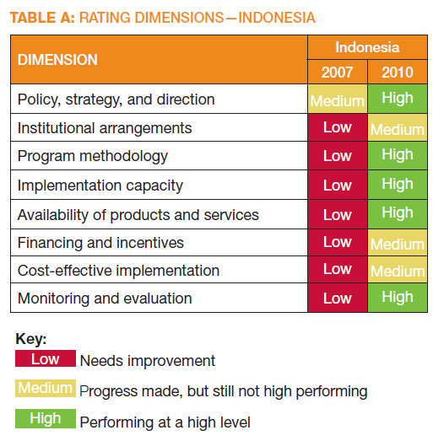
Proportion of HHs have access to improved sanitation | Average yearly increase 1993-2008 | Average yearly increase 2009 - 2011
Rural | 1.42% | 4.85%

Slide 15
Acceleration of Access in Indonesia
2040
Current and hypothetical rates of sanitation access increase in Rural Indonesia

