Slide 1
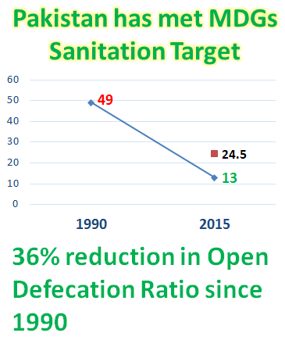
Achievement of MDG Target for Sanitation SDGs and Way Forward
Mr. Irfan Tariq, Director General, The Ministry of Climate Change, Pakistan
High Level Ministerial Meeting , 15 and 16 March 2016
@sanwatforall
Notes:
Please insert:
A picture from your country (your minister, or a WASH programme, or a stakeholder meeting/…)
The flag from your country
The name/s or the Minister/s presenting
The topic of your presentation: it can be one of the 5 building blocks and it can be an example from a specific sub-sector. It should be as much as possible relevant to prepare for the challenges posed by the SDGs ( how do we achieve universal, equitable, safely managed services)?

Slide 2
The issue we sought/seek to address
Sought to address: Taking Rural Sanitation at Scale in Pakistan
MDG Target for sanitation has been achieved in 2015
Pakistan Approach to Total Sanitation (PATS) has changed lives of millions of Pakistanis who live in ODF communities now
National Strategy to Accelerate Reduction in OD
PACOSAN II – Provinces defining WASH sector road maps
Seek to address:
Sustainability Check Study to inform WASH programmes ensure sustainable WASH services
Regular Joint Sector Reviews to identify bottlenecks and inform WASH Theory of Change
Define indicators, develop and roll-out strategies to meet SDG targets
ODF Punjab by 2018

Slide 3
What we are doing/did to address the issue
Took opportunity of 2010 flood to conceive and launch Pakistan approach to total sanitation (PATS)
Provincial governments rolling out PATS with government funding
Provincial WASH Sector Master Plans are being with convergence to other important sectors e.g. Nutrition for reduction in stunting
WASH TOC being jointly reviewed
National government in Policy formulation, coordination and reporting role

Slide 4
Outcomes/ lessons learnt/ next steps
Pakistan achieved MDG target of sanitation in 2015
Using and strengthening the government systems is key to go at scale
Alignment of new targets, strategies and PATS programmes with SDGs

Slide 5
Ideas on planning and reviewing progress of the SDGs
Background for discussions - not to be presented
Steps already undertaken to plan for the SDGs
Suggestions for a global review of progress
WASH related- Parliamentary task force on SDGs,
Broader process-Engaging the sector stake holders, consultative workshops, finalizing the indicators and setting the targets
Leadership of process/ steps/ MoCC Custodian of WASH mandate Provinces developing sector master plans
Use SDGs and agreed indicators as framework to monitor progress
Monitor and report progress biannually
Conduct annual Joint Sector Reviews
Use WASHBAT for JSR, JMP to monitor outcomes and GLAAS to monitor processes
Align Global commitments with regional and national priorities

Slide 6
Template 3: Bullet points list Learning from other countries: Key topics and countries we would like to learn about
High Level Ministerial Meeting , 15 and 16 March 2016
@sanwatforall
Notes:
Please insert:
A picture from your country (your minister, or a WASH programme, or a stakeholder meeting/…)
The flag from your country

Slide 7
Learning from each other
We would like to hear more of/ from the following:
Priority building blocks
Institutional arrangements
Planning, monitoring and review
Priority thematic issues
Private sector involvement and innovation
Equitable financing mechanisms for WASH
Countries
Sri-Lanka – Institutional arrangements and institutional WASH
Notes:
Which one of the key building blocks would you like to discuss in more depth?
Which subsector issues would you like to discuss in more depth?
Are there any countries in particular that you would like to learn from / exchange with?

