Slide 1
Lessons learned from the MDG period in water and sanitation Bruce Gordon WASH Coordinator, WHO Addis Ababa, Ethiopia, 15 March 20016

Slide 2
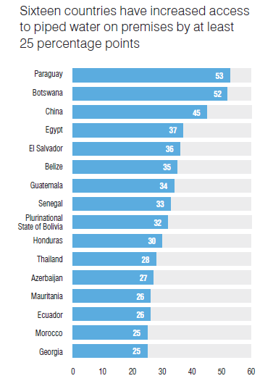
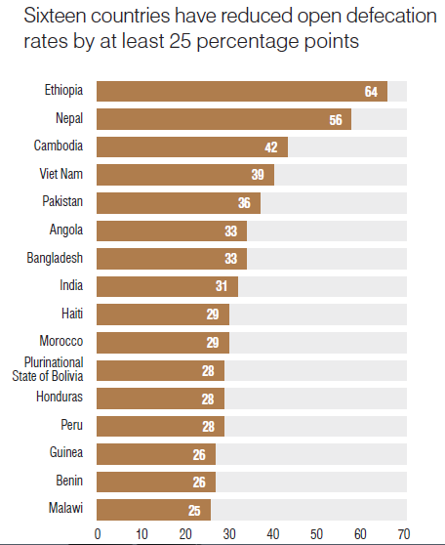
Lesson #1: Huge gains in WASH are possible
Source: WHO/UNICEF JMP, 2015
Notes:
We can do it - considerable progress over the MDG period in access to water
147 countries have met the MDG drinking water target
2.6 bn gained access.
Nearly 3/4: piped water on premises
Ethiopia example in reduction in OD: from 1990 to 2012, open defecation in Ethiopia fell by 55 percentage points, from 92% to 37%3.
Countries are doing many things right, but there is still room for improved approaches

Slide 3
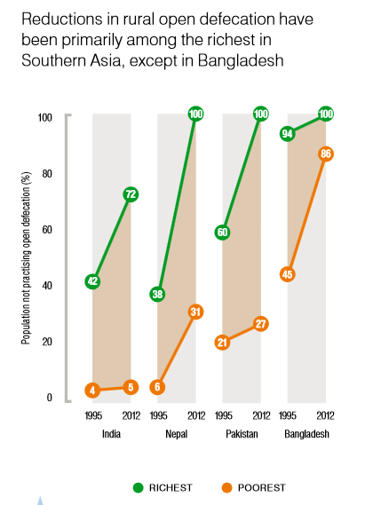
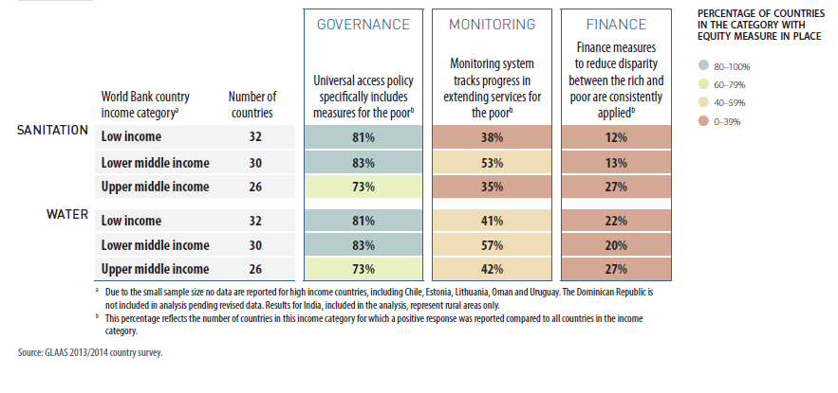
Lesson #2: Don't wait: target the disadvantaged now
< 60%
Countries specifically monitor progress of populations living in poverty
> 70%
Countries have universal access policy with measures for poor populations
< 30%
Countries consistently apply finance measures to reduce rich-poor disparity
MDG efforts:
Failure to identify, plan and monitor efforts for "disadvantaged groups"
MDG results:
Richer populations often benefit first, widening inequality
Source: WHO/UNICEF JMP, 2015; UN-Water GLAAS (WHO), 2014, OECD
Notes:
-But behind these gains, massive inequalities persist (many countries with impressive access gains are struggling to provide services to those rural areas and peri urban slums)
-Note the two sources of data: JMP and GLAAS
Second Lesson is "Don't wait…"
-on the right hand side of the slide, we see that richest wealth quintile gain services at an accelerated rate, furthering inequality; often countries achieve near 100% among the before substantive gains are made
We know from the GLAAS, that very few countries have begun to put in place policy measure to address the poorest, but that less than a third report implementing this in a systematic, meaningful way.

Slide 4
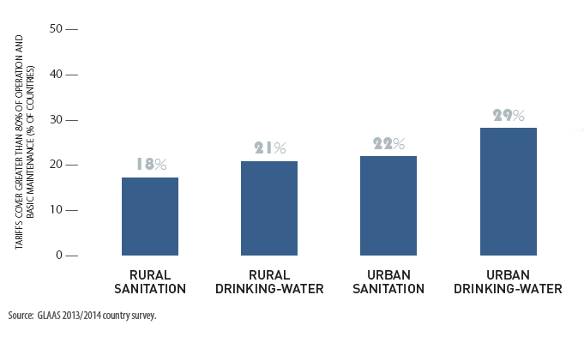
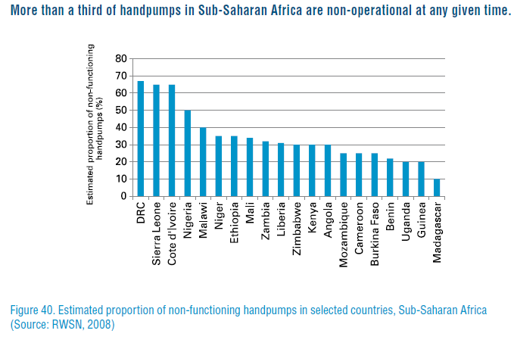
Lesson #3: Sustainability: keep WASH systems functioning over time
Few countries indicate that tariff revenues cover the majority2 of operation and basic maintenance costs.
MDG efforts:
Inadequate resource flow to maintenance
MDG results:
More than a third of sub-Saharan handpumps non-functional
Source: WHO/UNICEF JMP, 2015; UN-Water GLAAS (WHO), 2014, OECD
Notes:
Relative prioritization
-Resources flow from donors
Sustainability of revenue strains
-Few countries indicate that tariff revenues cover the majority of operation and basic maintenance costs.
-Population growth.

Slide 5
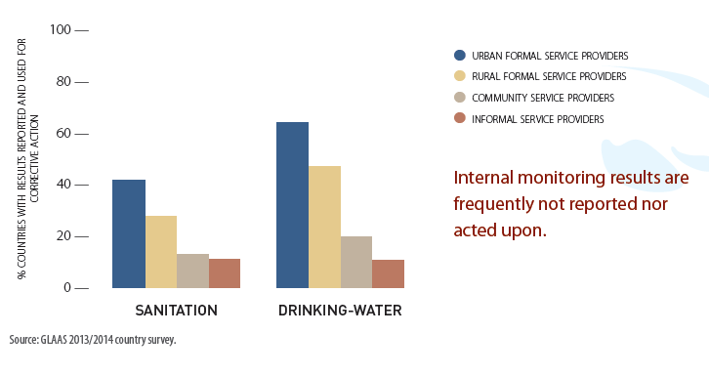
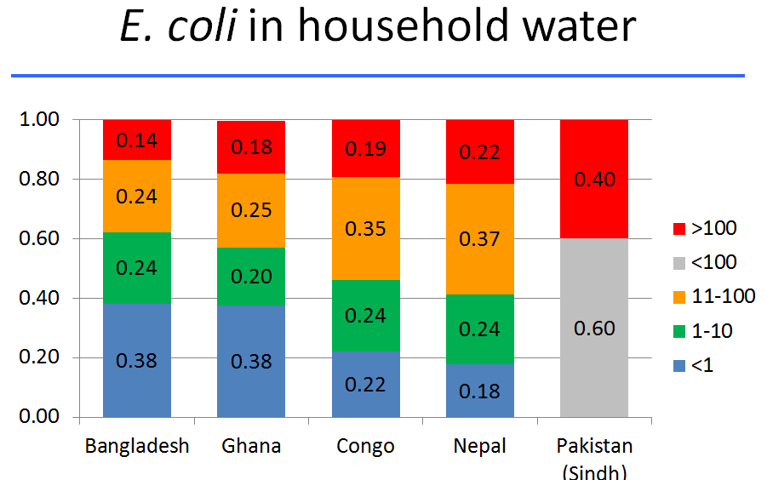
Lesson #4: Strengthen support for country institutions charged with planning, implementation and oversight
MDG efforts:
Increasing country-led planning
Weak regulatory oversight and corrective actions
MDG results:
Disparities in service level quality
Neglect for WASH in public places
Source: WHO/UNICEF JMP, 2015; UN-Water GLAAS (WHO)
Notes:
-Less than half:
-Countries reported having undertaken a national assessment for water and sanitation (e.g. Joint Sector Review) since 2012
-Countries carrying out independent surveillance of dw against standards in rural areas, and even less using result to trigger improvements
Schools and health facilities should be supported by strong and supportive MoE and MoH, but access levels
We need strong country institutions – a strong regulator facilitating support, but also enforcement.
Little capacity to track wq, much less tracking functionality of systems in san + dw

Slide 6
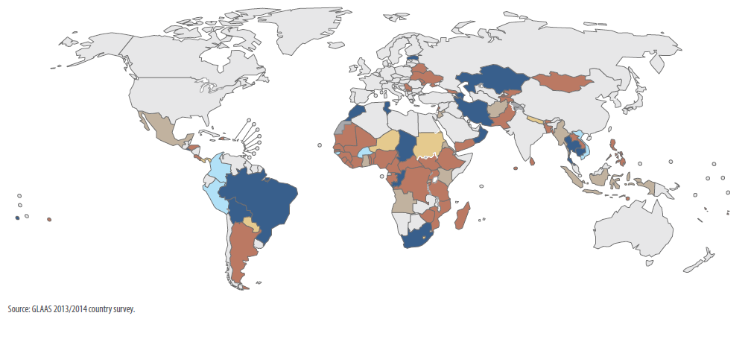
Lesson #5: Increase efficiencies in financing WASH
Huge financing gap between budgets and plans, with 80% of countries indicating insufficient financing.
MDG Efforts
Less than half of countries report using indicators to track expenditure against established baseline data for water and less than a third for sanitation.
Notes:
Financial indicators
-80% of countries report that current levels of financing are insufficient to meet targets established for drinking-water and sanitation,
-few actually track financial performance indicators against baseline data. Less than half of countries report using indicators to track expenditure against established baseline data for water and less than a third for sanitation. Tracking expenditure can be used at service provider level but also nationally to track against international commitments.

Slide 7
Lesson #6: Don't underestimate SDG aspirations
SDG WASH targets 6.1 and 6.2 go beyond basic to "safely managed" services
The total cost of providing WASH services at these levels is estimated at around $114 billion per year, three times the current investment levels.
Enabling environment is key: effective Institutions and leadership
Source: Hutton G and Varughese M (2016) The costs of meeting the 2030 sustainable development goal targets on drinking water, sanitation and hygiene. Water and Sanitation Program (WSP), World Bank, Washington DC.
Notes:
If the current global expenditure, estimated at around $28.4 billion per year, were to be targeted properly, every household in the world would have access to drinking water, an adequate toilet and a suitable place to wash their hands by 2030
if existing resources were targeted properly we could have access to basic WSS. We have been very careful to nuance that point in the costing report that what the number really demonstrates is that even when financing exists there is no guarantee of achieving the results – the institutions (or enabling environment) and leadership are key

