Slide 1
2016 SWA Meeting of Ministers of Water, Sanitation and Hygiene: Technical Meeting
Addis Ababa, Ethiopia, 17 March
National accountability mechanisms in water services: examples from Portugal
Jaime Melo Baptista (Portugal)
Former Chairman of the Portuguese Regulator (ERSAR)
President of the Strategic Council of PWP Member of the Board of IWA
Principal Research Officer at LNEC

Slide 2
National accountability mechanisms
Water supply and sanitation are public, essential and monopolistic services.
Effective service provision relies upon the actions of different stakeholders (mainly government, administration and utilities).
The provision of water services should preserve accountability of those different stakeholders.
The regulatory authority has the main responsibility to accomplish that target.
We will describe briefly the Portuguese case.

Slide 3
National accountability mechanisms
Usual accountability tools:
Plans and activity reports.
Cross-cut administrative and financial control.
Other additional tools:
Public consultations.
Advisory body (stakeholders) hearings.
Parliamentary hearings.
And still:
Assessment and public dissemination of the performance of the sector and the utilities.

Slide 4
National accountability mechanisms
Assessment and public dissemination:
The regulator should ensure a suitable assessment system about the performance of the sector and the utilities.
Based on that system, it should carry out annual regulation cycles to access the performance.
The regulator should follow specific, clear, stable and rational regulatory procedures to access not only situation in that specific year but also the evolution on time.

Slide 5
National accountability mechanisms
Procedures according the regulatory model:
Structural regulation of the sector:
Contribution to the organisation of the sector.
Contribution to the legislation of the sector.
Contribution to the capacity building of the sector.
Contribution to the information of the sector.
Behavioural regulation of the utilities:
Legal and contractual regulation.
Economic regulation.
Quality of service regulation.
Drinking water quality regulation.
Consumers interface regulation.
Data
Information system
Data
Data + KPI
Regulatory cycles
Data + KPI
Data + KPI
Data

Slide 6
National accountability mechanisms
In Portugal the regulator ERSAR :
Assess and publicly disseminate annually the following performance indicators (KPI) of the (400) water utilities, among others:
50 economic and financial KPI (40 000 data).
32 quality of service KPI (50 000 data).
50 drinking water quality indicators (800 000 data).
This represents about one million data per year, which are freely available (data + indicators).
This is a complex and demanding task.
How to deal with it? (ex. quality of service)

Slide 7
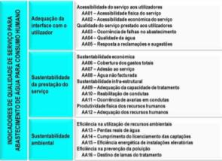
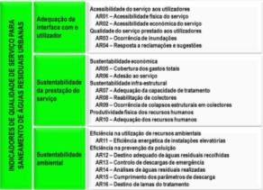
National accountability mechanisms
Design of the assessment system

Collection of data

Validation of data (local audits)

Processing to calculate KPI

Interpretation of the KPI

Benchmarking of water utilities

Public dissemination of results
Information system
16 KPI for WS
16 KPI for WW
50 data for WS
50 data for WW
Utility´s profile
System´s profile Context factors
Targets (including from SDG)
12 years of continuous monitoring give an excellent understanding of the evolution of the sector & services (www.ersar.pt).

Slide 8
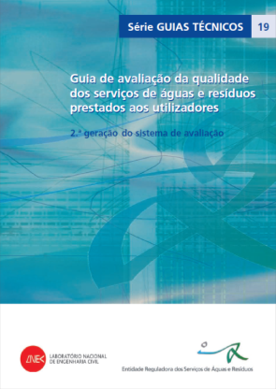
National accountability mechanisms
Quality of service indicators
for the water supply services
Social sustainability
Physical accessibility of the service
Economic accessibility of the service
Occurrence of supply interruptions
Quality of supplied water
Reply to written suggestions and complaints
Coverage of total expenses
Effective connection to the service
Non-revenue water
Adequacy treatment capacity
Mains rehabilitation
Mains failures
Adequacy of human resources
Water losses
Fulfilment of the water intake licensing
Energy efficiency of pumping installations
Disposal of sludge from the water treatment
Service management sustainability
Environ-
mental sustainability
We can add indicators for public health, poverty, gender, employment, etc.

Slide 9
National accountability mechanisms
Quality of service indicators
for the waste water services
Social sustainability
Physical accessibility of the service
Economic accessibility of the service
Flooding occurrence
Reply to written suggestions and complaints
Coverage of total expenses
Effective connection to the service
Adequacy of treatment capacity
Sewerage rehabilitation
Sewer collapses
Adequacy of human resources
Energy efficiency of pumping installations
Appropriate disposal of collected wastewater
Emergency control discharges
Wastewater analysis
Compliance with discharge parameters
Disposal of sludge from the wastewater treatment
Service management sustainability
Environmental sustainability
We can add indicators for public health, poverty, gender, employment, etc.

Slide 10
National accountability mechanisms
But all the blocks of public policy must be included in the accountability practise:
Strategic plans.
Legislative framework.
Institutional framework.
Governance models.
Service access targets.
Quality of service goals.
Tariff and tax policy.
Financial resources.
Construction of infrastructures.
Operation of infrastructures.
Human resources.
Research and innovation.
Entrepreneurship.
Competition.
Consumers protection.
Social engagement.
Ethics and integrity.
Data and information.

Slide 11
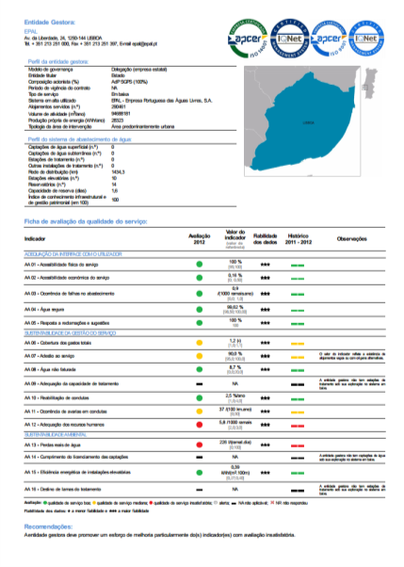
National accountability mechanisms
Annual assessment of the performance for all the utilities (400) for (2x16) KPI:

Slide 12
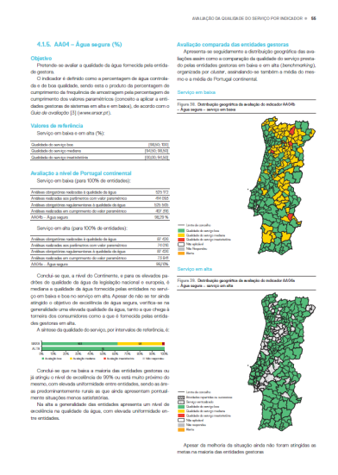
National accountability mechanisms
Annual benchmarking for all the utilities & each KPI
(2 x 16), with 9 clusters.
www.ersar.pt

Slide 13
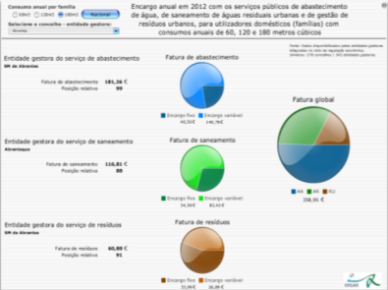
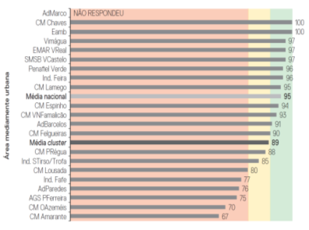
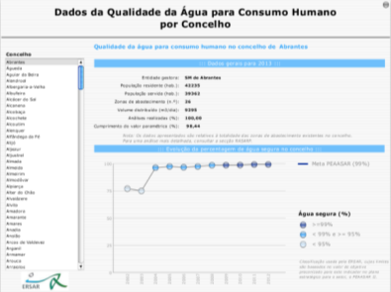
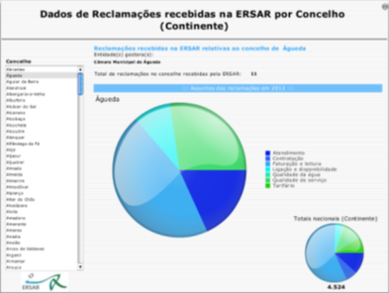
National accountability mechanisms
The citizens have full access to this information available in Internet (www.ersar.pt):
www.ersar.pt

Slide 14
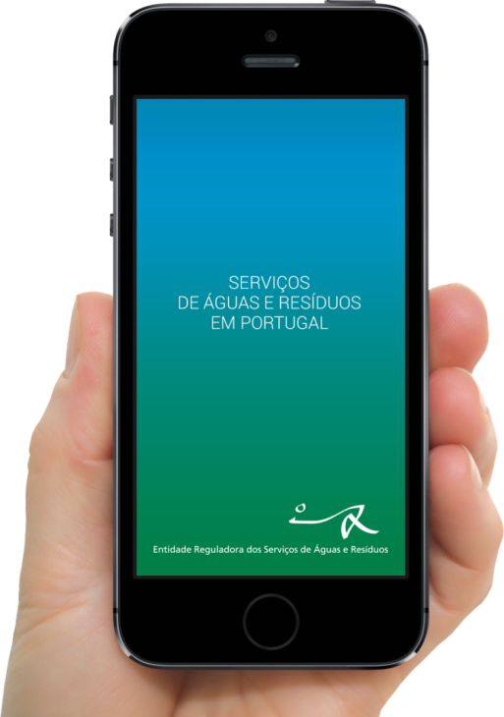
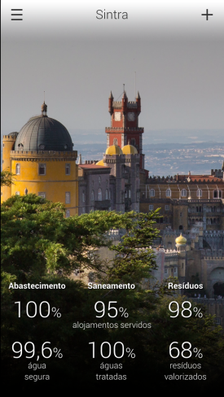
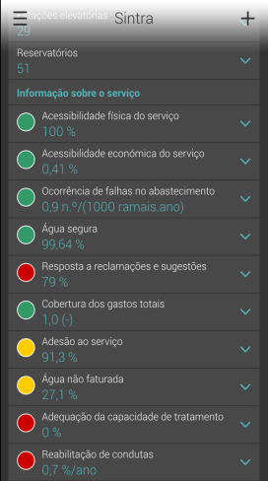
National accountability mechanisms
The citizens have also the information available in their smartphones (App ERSAR):
This last tool is very nice, the top of the cake, but it is not structural.
The real import task is to define and implement annually an assessment system of the performance of the sector and the utilities!
Go ahead! This is possible! Commit yourself!

Slide 15
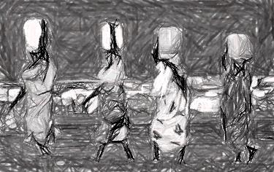
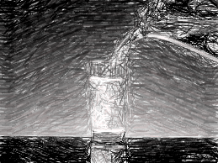
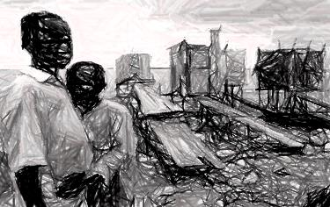
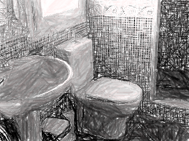
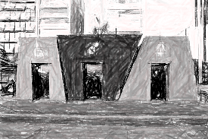
Thanks for your attention!
jmbaptista@lnec.pt

