Slide 1
Meeting of Ministers of Water, Sanitation and Hygiene, Day 3
Action Planning to Reach the Water, Sanitation and Hygiene SDG´s – 17 March 2016
Addis Ababa, Etiopia
Yamilette Astorga Espeleta, M.Sc.
Excecutive President
Costa Rican Institute for Water Supply and Sanitation

Slide 2
How useful is monitoring the collaborative behaviours and in what way?
The monitoring of collaborative behaviours allow to know and measure by different indicators that include:
Governance: Wash planning, financial, participatory process, building capacity
Collection of data: Analysis and use for decision making

Slide 3
How can the data gaps be addressed?
In Costa Rica we have an Annual Report on the State of the Nation, made by the Universities Council and with the participation and validation of the different stakeholders, which include:
Trends on water supply and sanitation and definition of the goals for the “Development National Plan Alberto Cañas Jerez”
Suggestion:
The harmonization of the data among the different institution, feed our National Information System on Integrated Water Resources Management (SINIGIRH)
To include the Collaborative Behaviours but also SDG´s indicators
To maintain update the data from the state of the Community Water Boards (ASADAS), that are the rural areas operators

Slide 4
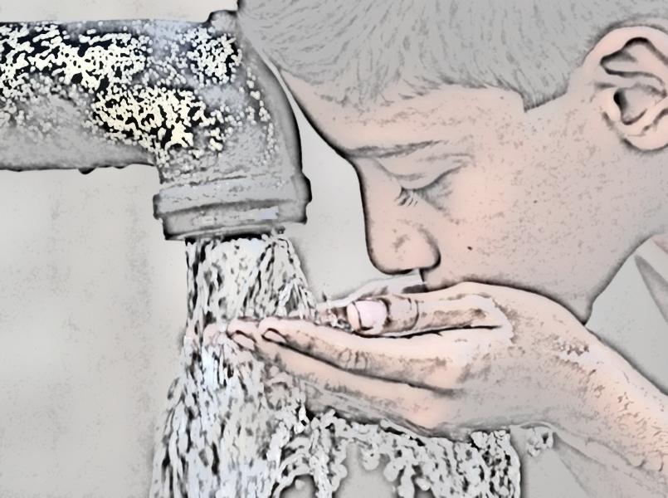
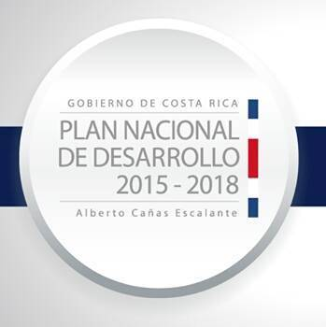

Slide 5
How can the data gaps be addressed?
In Latin America, through Latinosan we agree to built a WASH Observatory
Suggestion:
To include the Collaborative Behaviours but also SDG´s indicators
To include the state of WASH in rural areas

Slide 6
How can the data gaps be addressed?
By involvement other stakeholders for the plan building
Development Bank Agencies that borrow money for investment in infrastructure, for instance:
Central American Integration Bank (BCIE)
Inter American Development Bank
Regulators
Other operators like “Community Water Boards”
Universities
NGO´s and CSOs

Slide 7
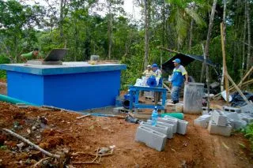
How best to address the issue of gathering ESA country level data?
To support our national and Latin America observatory
To support the collection and the maintenance of the field collecting data of rural areas.

Slide 8
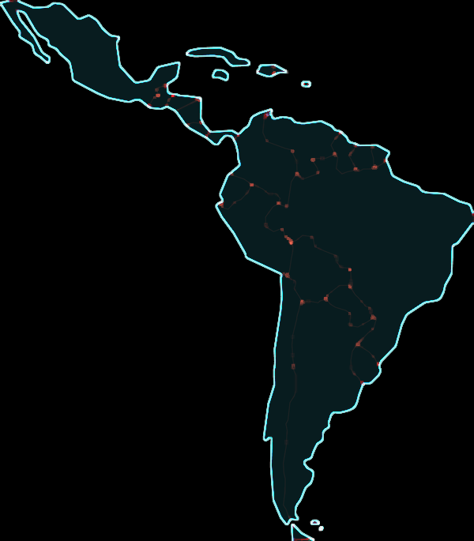
Last suggestion
SWA should have more presence in Latin America

Slide 9
Thanks a lot for all!!
Yamilette Astorga Espeleta, M.Sc.
Excecutive President
Costa Rican Institute for Water Supply and Sanitation
E-mail: yastorga@aya.go.cr

